Slide 1



Exploring JS (3)
By Elham Jaffar

Slide 2
Built-ins

Slide 3
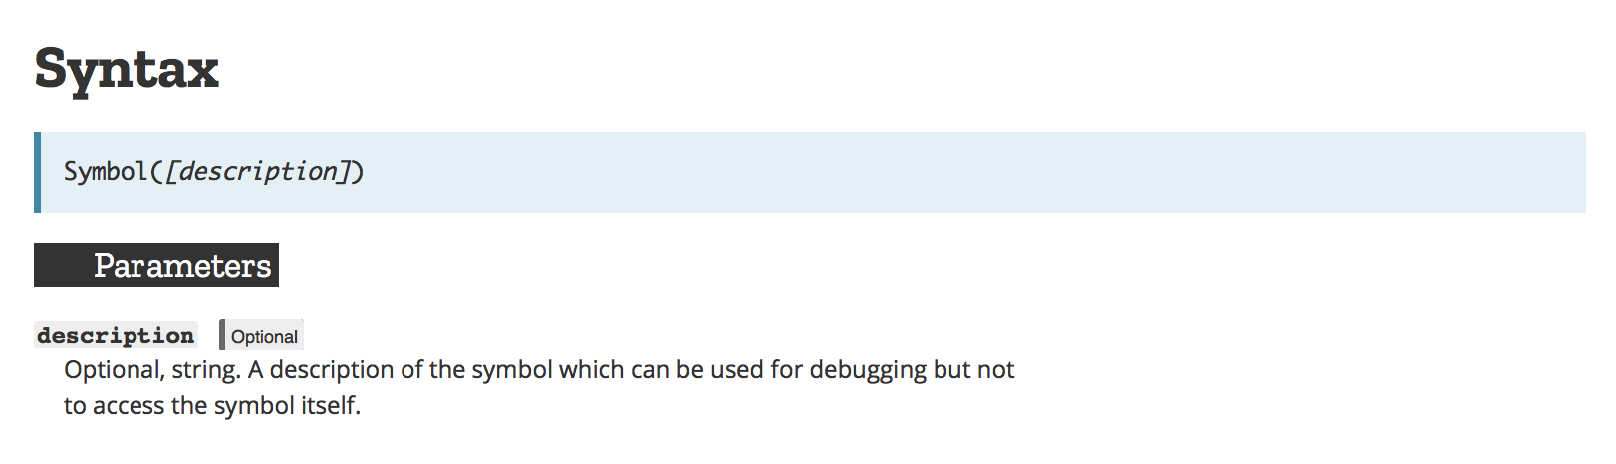
Symbols
Symbols are a new primitive. Just like the Number, String, and Boolean primitives, Symbols have a Symbol function which can be used to create them.

Slide 4
Iterable & Iterator
Introduction to Iterator, Iterable and Generator

Slide 5
Math set
Set is a collection of distinct items.
Currently, in JS ES5 we have a set which array !
But there is a problem ?? It does’t recognize the duplicate
How to solve it ?

Slide 6
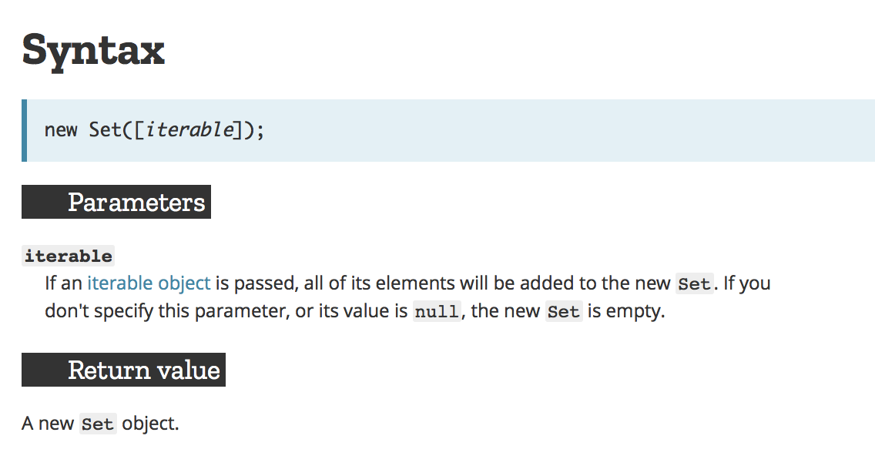
Es6 math set
The Set object lets you store unique values of any type, whether primitive values or object references.

Slide 7
Math set methods
add() → To add new element
delete(‘e’) → delete a specific element
clear()→ clear the set
size → return the size
has(‘e’) → check if the element exists in a set
values() → return values
keys()→ return alias for .values()
next() → it uses with the iterator to move to next element

Slide 8
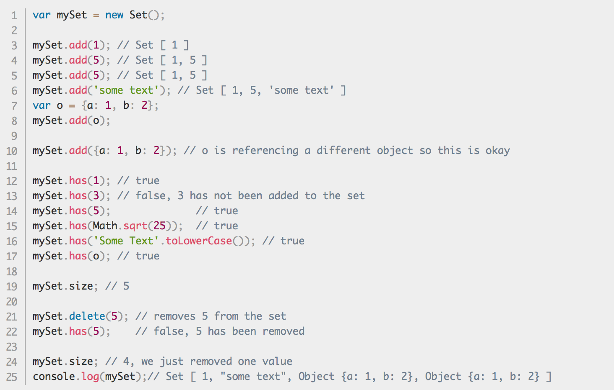
Math set methods

Slide 9
Weak set
WeakSet objects are collections of objects. An object in the WeakSet may only occur once; it is unique in the WeakSet's collection.
The main differences to the Set object are:
In contrast to Sets, WeakSets are collections of objects only and not of arbitrary values of any type.
Doesn’t have .clear() method
Syntax: new WeakSet([iterable]);

Slide 10
Map
The Map object holds key-value pairs. Any value (both objects and primitive values) may be used as either a key or a value.
Syntax: new Map([iterable]);

Slide 11
Object vs map
The keys of an Object are Strings and Symbols, whereas they can be any value for a Map, including functions, objects, and any primitive.
You can get the size of a Map easily with the size property, while the number of properties in an Object must be determined manually.
A Map is an iterable and can thus be directly iterated, whereas iterating over an Object requires obtaining its keys in some fashion and iterating over them.
An Object has a prototype, so there are default keys in the map that could collide with your keys if you're not careful. As of ES5 this can be bypassed by using map = Object.create(null), but this is seldom done.
A Map may perform better in scenarios involving frequent addition and removal of key pairs.

Slide 12
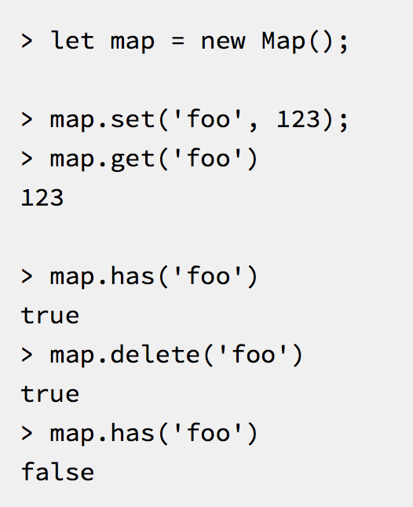
Map methods

Slide 13
Weak map
The WeakMap object is a collection of key/value pairs in which the keys are weakly referenced. The keys must be objects and the values can be arbitrary values.
Syntax: new WeakMap([iterable]);

Slide 14
Promise
The Promise object represents the eventual completion (or failure) of an asynchronous operation, and its resulting value.
Promise Usage
Notes:
http://es6-features.org/#PromiseUsage

Slide 15
Promise
The Promise object represents the eventual completion (or failure) of an asynchronous operation, and its resulting value.
Promise Usage
Notes:
http://es6-features.org/#PromiseUsage

Slide 16
Promise vs call back
A callback is a function that is passed to an another function. A callback may or may not be executed asynchronously.
A Promise is a object which takes a callback and executes it asynchronously and it returns a promise object.
Notes:
http://es6-features.org/#PromiseUsage

Slide 17
proxy
The Proxy object is used to define custom behavior for fundamental operations (e.g. property lookup, assignment, enumeration, function invocation, etc).
Proxies are a powerful new way to create and manage the interactions between objects.
var p = new Proxy(target, handler);
Notes:
http://es6-features.org/#PromiseUsage

Slide 18
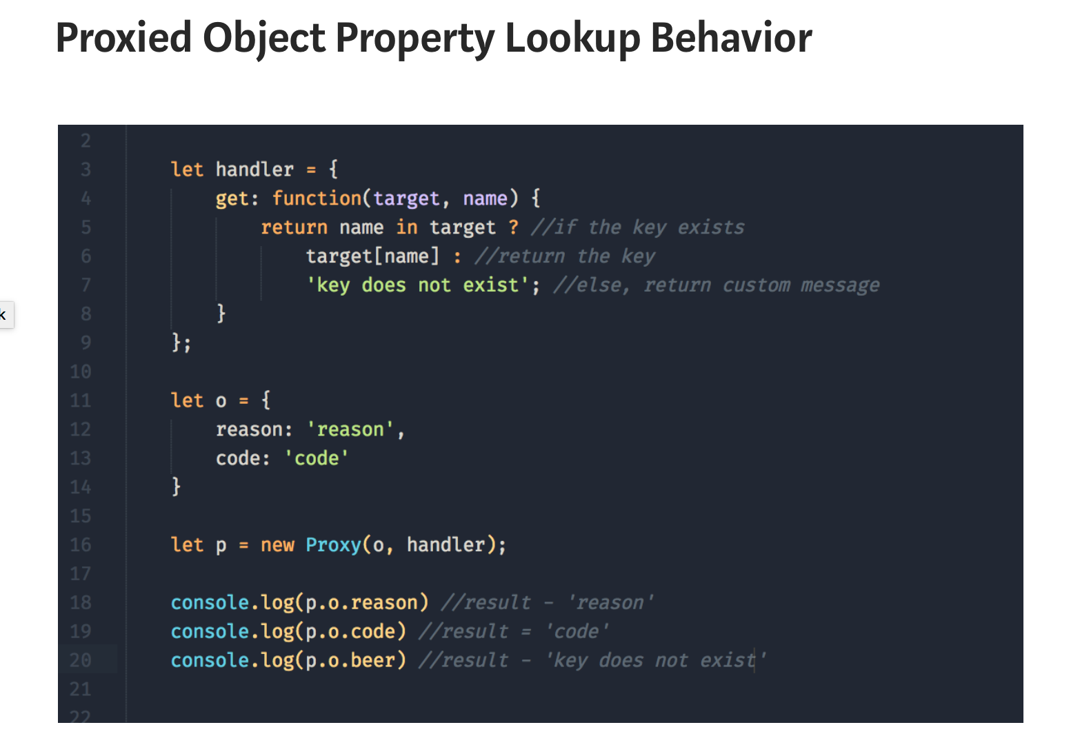
Proxy example
Notes:
http://es6-features.org/#PromiseUsage

Slide 19
Proxy real applications
There are many real-world applications for Proxies
validation
value correction
property lookup extensions
tracing property accesses
revocable references
implementing the DOM in javascript
Notes:
http://es6-features.org/#PromiseUsage

Slide 20
generator
The function* declaration (function keyword followed by an asterisk) defines a generator function, which returns a Generator object.
WHAT IS A GENERATOR OBJECT?
Notes:
http://es6-features.org/#PromiseUsage

Slide 21
generator
A generator object is a special type of function that can be entered and exited a number of times. You might hear people describe it as, “a function that can be paused”.
The yield keyword is used to pause and resume a generator function.
function* foo(index) {
while (index < 2) {
yield index++;
}
}
Notes:
http://es6-features.org/#PromiseUsage

Slide 22
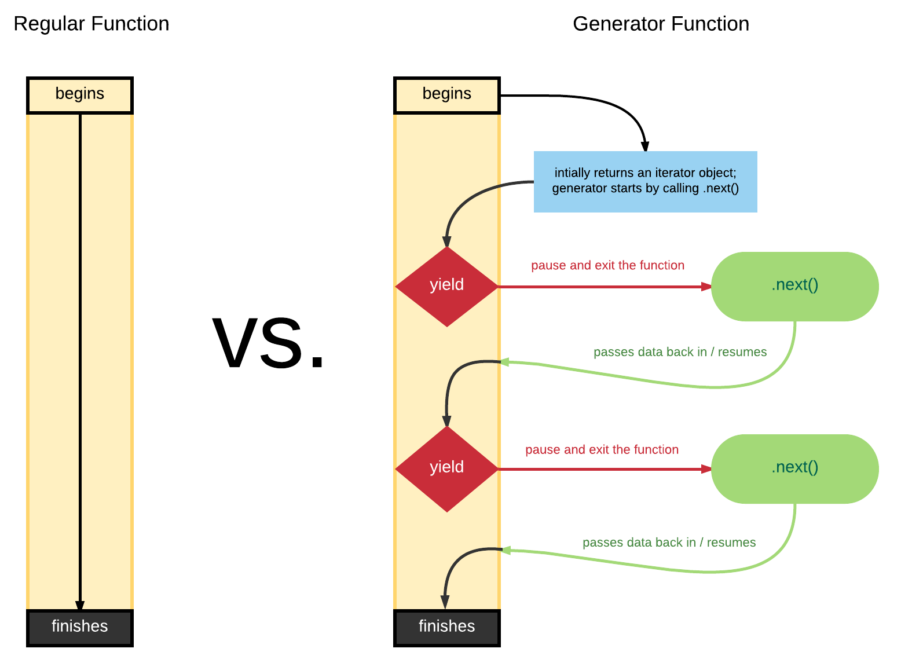
generator
Notes:
http://es6-features.org/#PromiseUsage

Slide 23
Exercise Challenge (1)
Write an arrow function which accepts a number as input and insert dashes (-) between each two even numbers.
// For example if you accept:
// 025468
// The output should be:
// 0-254-6-8
Notes:
https://www.w3resource.com/javascript-exercises/javascript-function-exercise-6.php

Slide 24
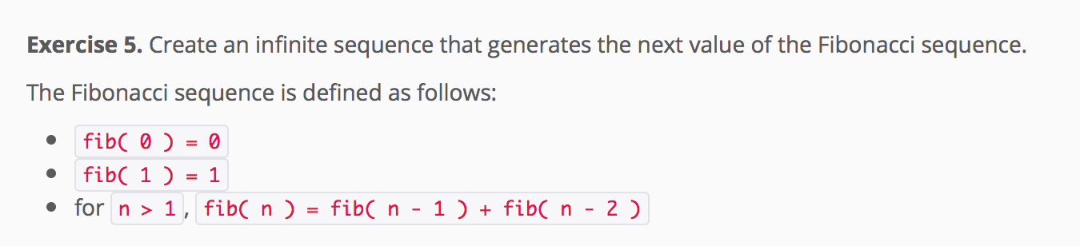
Exercise Challenge (2)
Notes:
https://www.w3resource.com/javascript-exercises/javascript-function-exercise-6.php

Slide 25
Arcade Game Project

Slide 26

Remember that we are here to help you
All you have to do is ASK!
Thank you for Attending

